Slide 1
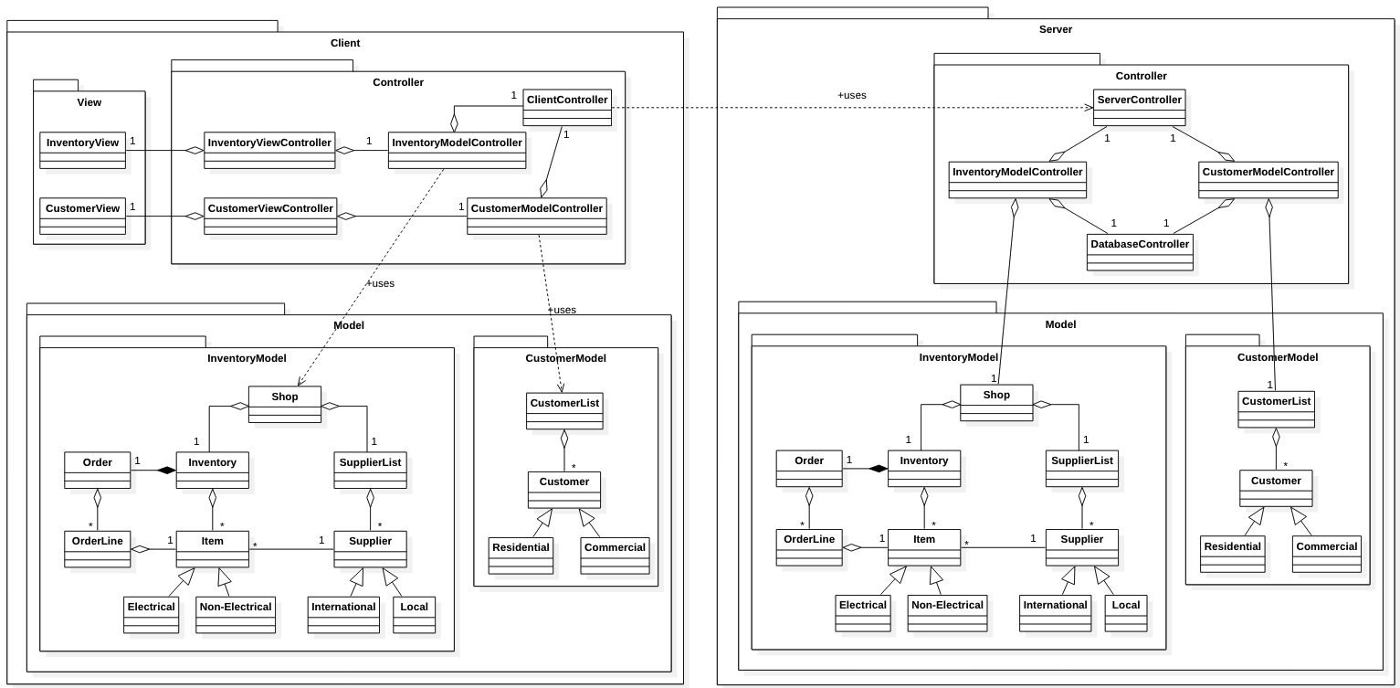
Overall UML Diagram

